Slide 1
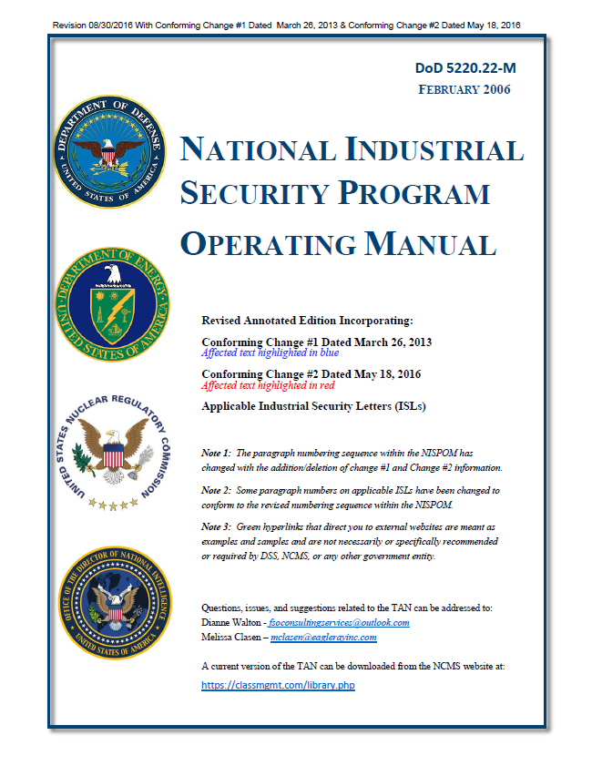
The Annotated NISPOM is located on the NCMS web site located at the following link: https://classmgmt.com/ in the members only section. To locate the Annotated NISPOM click Resource Library on the navigation tab on the left of the page then choose the Policies Resources link. On that page, you will choose the DoD link at the top of the page. The Annotated NISPOM is the first document in the list under DoD
Introduction to the Annotated NISPOM
If you have any questions, suggestions, or comments, please email Dianne Walton, FSO Consulting Services, L.L.C at fsoconsultingservices@outlook.com or call 407-963-2020

